Slide 1




Azure Cognitive Search Deep Dive
Riccardo Cappello
Senior Consultant @
Microsoft Azure MVP
Intel Software Innovator
rcappello@outlook.com

Slide 3






Azure Cognitive Search Pipeline
Data
Source
Enriched
Documents
Ingest Enrich Explore
Any Data format
Any Azure Store
Cognitive Skills
Azure Search API
Portal
Notes:
Azure Search feature, Announced in May 2018 (MS Build)
It uses AI to create searchable metadata, transforming unstructured data into information
Data Enrichment =! Data Integration. Original data isn’t moved, changed or copied
Results are always loaded into an Azure Search Index
10+ regions, including South Central US, West Europe, North Europe, Brazil South, and Southeast Asia
Azure Search Cost + Cost per image + Cost per Cognitive Service used
OR Azure Search Cost + Free up to 20 documents per day
Document cracking: The process of extracting or creating text content from non-text sources during indexing. Optical character recognition (OCR) is an example, but generally it refers to core indexer functionality as the indexer extracts content from application files. The data source providing source file location, and the indexer definition providing field mappings, are both key factors in document cracking.

Slide 4
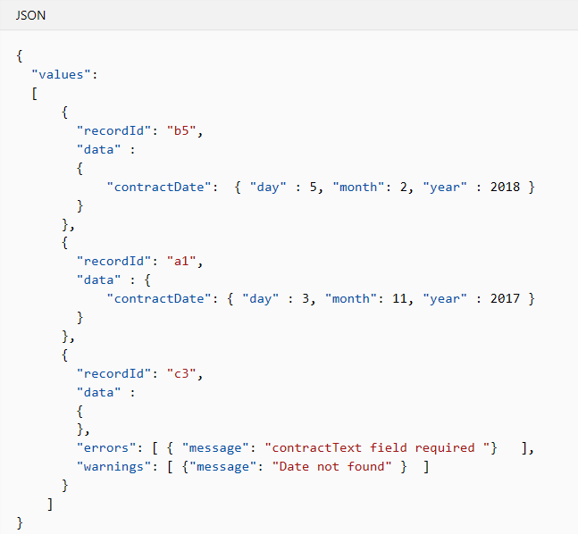
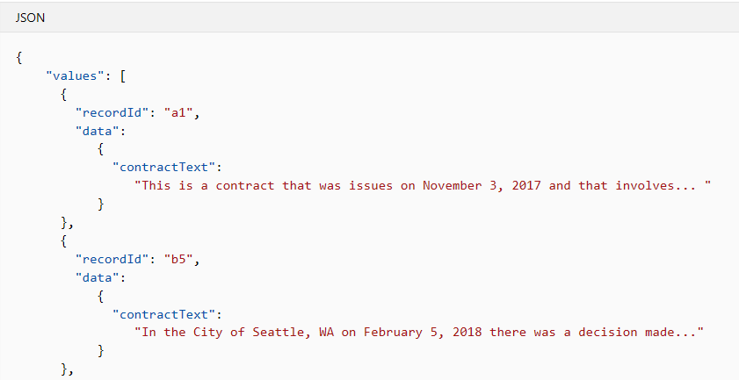
Custom Cognitive Skill
Microsoft.Skills.Custom.WebApiSkill allows to extend cognitive search by calling out to a Web API endpoint providing custom operations
OUTPUT
INPUT
We can use our AI models and perform operations to enrich documents

Slide 5
DEMO

Slide 6
References
https://github.com/marcominerva/PeopleFinder
https://docs.microsoft.com/en-us/azure/search/cognitive-search-predefined-skills
https://docs.microsoft.com/en-us/azure/search/cognitive-search-custom-skill-interface
https://azure.microsoft.com/en-us/services/cognitive-services/face
https://en.wikipedia.org/wiki/Exif
https://azure.microsoft.com/en-us/services/azure-maps

Slide 8
Thank You!!!
Riccardo Cappello
Senior Consultant @
Microsoft Azure MVP
Intel Software Innovator
rcappello@outlook.com

